Slide 1
The Last Week Of Jesus’ Life (Part 2)
Matthew 21:12-13; Mark 11:15-19; Luke 19:45-48; 21:37-38
June 1, 2022

Slide 2
The Journey To Jerusalem
Crossed into the region beyond Jordan. Matthew 19:1
Samaritans refuse to receive Jesus. Matthew 19:1
Samaritan Healed. Luke 17:11
Stopped in Bethany.
Rested on the Sabbath day. John 12:1
Healed two blind men, visited Zacchaeus. Luke 18:35-19:10
About 1,200 feet below sea level.

Slide 3
Sunday
Preparation:
Secures the colt. Matthew 21:1-7
The Procession Into The City.
Multitude spread their garments on the road. Matthew 21:8
Shouts Of The People As Jesus Entered. Mark 11:9-10, “Blessed (is) the kingdom that cometh, (the kingdom) of our father David: Hosanna in the highest.”
My kingdom is not of this world. John 18:36

Slide 4
Sunday
The Response Of The Pharisees.
Luke 19:39-40, “Teacher, rebuke Your disciples.”
Matthew 21:14-15, “And the blind and the lame came to him in the temple; and he healed them. But when the chief priests and the scribes saw the wonderful things that he did, and the children that were crying in the temple and saying, Hosanna to the son of David; they were moved with indignation.”

Slide 5
Sunday
Prophecy of Jesus.
Luke 19:41-44, “And when he drew nigh, he saw the city and wept over it, saying, If thou hadst known in this day, even thou, the things which belong unto peace! but now they are hid from thine eyes. For the days shall come upon thee, when thine enemies shall cast up a bank about thee, and compass thee round, and keep thee in on every side, and shall dash thee to the ground, and thy children within thee; and they shall not leave in thee one stone upon another; because thou knewest not the time of thy visitation.”
Return to Bethany. Mark 11:11

Slide 6
Monday
Overview:
Jesus pronounced judgment on the unproductive fig tree. Mark 11:12-14
Jesus entered the temple and cast out the merchandisers. Mark 11:15-18
Jesus had cast out the merchandisers early on in his ministry. cf. John 2:13-25
Jesus and the disciples return to the mount of olives (Bethany, Matthew 21:17; Luke 21:37), in the evening.

Slide 7
Monday
Jesus Pronounced Judgment on the unproductive fig tree. Mark 11:12-14; Matthew 21:18-22
Nature of fig trees: “On this kind of tree the fruit forms before the leaves and should be full grown before the leaves appear; so this tree, by putting on its foliage before the time for figs, was proclaiming itself superior to all other fig trees. This made it a striking symbol of the hypocrite, who, not content with appearing to be as good as other people, usually puts on the appearance of being a great deal better.” (J.W. McGarvey)

Slide 8
Monday
Jesus entered the temple and cast out the merchandisers. Mark 11:15-18; John 2:13-25
The temple was more than just one building.
As Jesus came into the courtyards of the temple He grew angry.
As Jews came from all parts of the world to Jerusalem to worship, they were provided sacrifices (cf. Numbers 28:16-25).
The authorities were supposedly helping those who had traveled to Jerusalem by providing a place where the necessary sacrifices could be purchased.
Yet, these were taking advantage of the people.
Even those who changed money for that currency used in Judea were taking advantage of those who came to worship God.

Slide 9
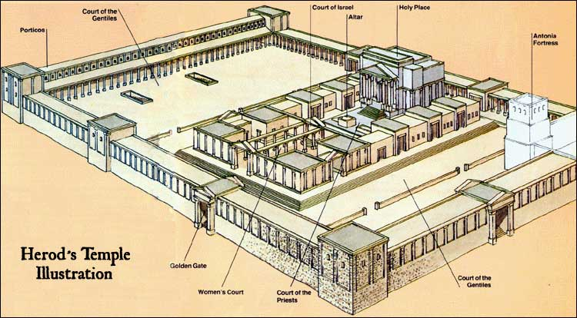
http://www.bible-history.com

Slide 10
Monday
Jesus cast out those that bought and sold in the temple.
Jesus overthrew the tables of the money changers.
Jesus overthrew the seats of them that sold doves.
Jesus would not allow any man to carry vessels through the temple.
Prophecy:
Isaiah 56:7, “even them will I bring to my holy mountain, and make them joyful in my house of prayer: their burnt-offerings and their sacrifices shall be accepted upon mine altar; for my house shall be called a house of prayer for all peoples.”
Jeremiah 7:11, “Is this house, which is called by my name, become a den of robbers in your eyes? Behold, I, even I, have seen it, saith Jehovah.”

Slide 11
Monday
Jesus entered the temple and cast out the merchandisers. Mark 11:15-18; John 2:13-25
What are we to learn?
The Lord’s church is not to be a house of merchandise! It is to be a house of prayer, worship, and edification.

Slide 12
Monday
Jesus and the disciples return to the Mount of Olives (Bethany, Matthew 21:17; Luke 21:37), in the evening.

Slide 13
The Temple: - LESSONS
In the Old Testament:
In the Tabernacle (Exodus 25:8-9; Leviticus 26:11-12; Deuteronomy 12:5; 3:1-6).
In the Temple built by Solomon (2 Chronicles 7:12-16).
God’s name is recorded there (Exodus 20:24).
In the New Testament
The church is the temple of God. (1 Corinthians 3:9; 16-17; Ephesians 2:19-22).
Built by Christ. (Matthew 16:18).
God’s name is recorded there. (Revelation 2:13; 3:8; Colossians 3:17; Acts 15:17; Ephesians 3:14-15).

Slide 14
The Temple -LESSONS
Must Be Built According To God’s Pattern:
The Old Testament plan (1 Chronicles 28:10-19; Exodus 25:40; Hebrews 8:1-5; 1 Corinthians 3:10-15; Psalms 127:1)
God’s plan for the New Testament church is found in New Testament Scriptures.

Slide 15
Christ and the Apostles are the Foundation:
The Temple of God, built upon teaching. (1 Corinthians 3:11; Ephesians 2:20).

Slide 16
Christians Are Stones Built Together Into the Temple of God: (Ephesians 2:19-22; 1 Peter 2:5, 6, 9-10).
Unbelievers and disobedient cannot be stones. (1 Peter 2:7-8)
The strength of the building depends on stones being securely cemented and built together in peace and love. (Ephesians 2:21-22; Ephesians 4:1-3, 16)

Slide 17
The Church Is A Spiritual Temple With A Spiritual Mission
The Church is the spiritual house of God. 1 Peter. 2:5
It is the family of God built by Christ. Matthew. 16:18; Acts 20:28
It is the spiritual body of saved people. Acts 2:47; Ephesians 5:23-27

Slide 18
What The Mission Of The Church Is Not:
Political …
The kingdom of Christ is not an earthly political force. John 18:33-38
God ordained civil government to meet all such issues. Romans 13:1-7; 1 Peter 2:13-17
Although individual Christians are subject to the powers that be, the church and state are distinct in mission and separate in function.

Slide 19
What The Mission Of The Church Is Not:
Economical …
Only evil men make “godliness a way of gain,” 1 Timothy 6:5
God gave the church a pattern by which to finance its work, 1 Corinthians 16:1-2; 2 Corinthians 9:7
Farming, manufacturing, or merchandising is simply not the function of the church.

